Slide 1
Project on Google as Company
Project team 10

Slide 2
Topics we covered
Introduction of Project on Google as company
Target audience and variable in our survey
Descriptive Analysis
Explanation
Key points

Slide 3
Introduction
This project would determine the reason of high rating of Google company.
Factors affects the current rating
Collection of data set provided by google employees
Compile analystic of employess whose dream to work in google as employee.
Key points defining why google is good place to work.

Slide 4
Google
GOOGLE was founded by Stanford college students name Larry Page and Sergey Brin in 1998.
They created a “Perfect search engine “ to help you find everything you need on the internet.
GOOGLE has become the most popular search engine in the world.

Slide 5
Target audience and Variable
Our dataset consists of reviews provided by Google employee The reviews are based on various aspects like “work-life balance”, “cultural values”, “career opportunities”, “benefits”.
The data is collected across various locations and job natures.
Glassdoor is one best website for job search show the details for google employees link is here : https://www.glassdoor.com/Overview/Working-at-Google-EI_IE9079.11,17.htm

Slide 6
Analysis of target employees
Analysis define the four component like by targeted employees
Values and Beliefs (that members hold for an organization) ○
Heroes (individuals who exemplify an organization's values)
Rites and Rituals (ceremonies where an organization celebrates its values)
Cultural Network (communication system through which cultural values are instituted and reinforced

Slide 7
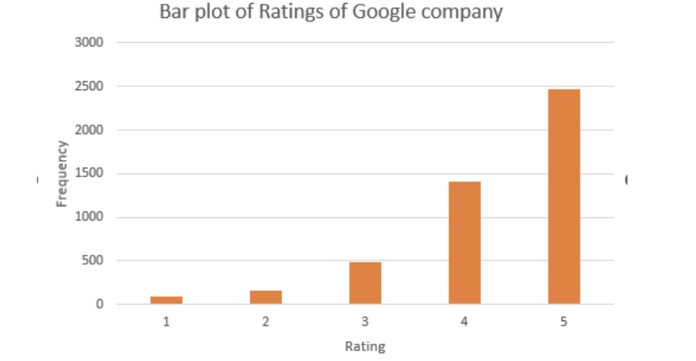
Descriptive Analysis through bar chart
To achieve the aims of this project descriptive analysis is applied which includes bar graph for evaluating the rating of Google company having maximum frequency.

Slide 8
Bar chart result
The bar plot indicated that maximum frequency appeared for rating of 5.
we can say that Google is top-rated company due to high rating and maximum frequency of participants for that rating.

Slide 9
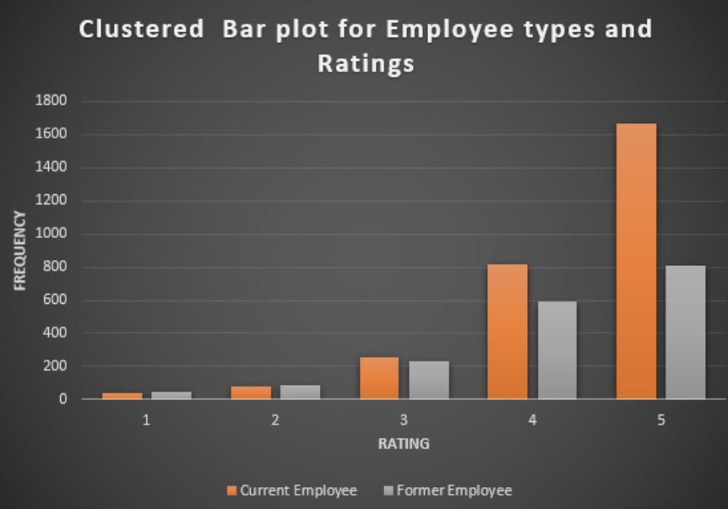
Descriptive Analysis through cluster chart
After determine the reason behind these high ratings we would create clustered bar plot for examining the comparison Employee types.

Slide 10
Cluster bar chart result
The clustered bar chart indicated high frequency for current Employer. Thus, we can say that current employees have highest frequency in rating Google company high.
The Google employer brand is strong. Despite concerns about the company's size and power, potential employees see Google as a top-tier employer.

Slide 11
Charts shows Google employer brand
These are the two key charts that illustrate the Google employer brand:
The first chart shows that Google is consistently ranked as one of the top employers, across a variety of industries.
The second chart shows that Google employees are highly satisfied with their jobs, and that satisfaction has been increasing over time.

Slide 12
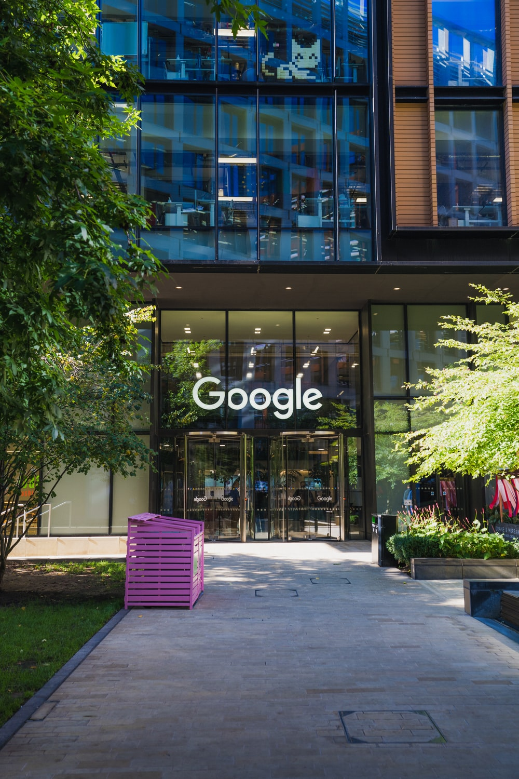
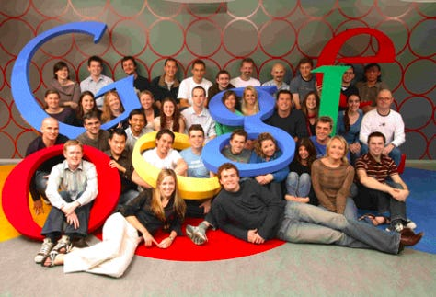
Google Company & Employee

Slide 13
Key Points of Google as company
Google is one of the most popular employers in the United States.
Google is especially popular among millennial.
Google is an attractive employer because of its high salaries and generous benefits.
Google is also an attractive employer because of its strong corporate culture.
Google is an attractive employer because of its innovative and cutting-edge technology.
Google is an attractive employer because of its global reach.
Google is an attractive employer because of its commitment to social responsibility.

Slide 14
Conclusion
Google is one of the most popular employers in the world because of :
Excellent benefits, great work-life balance, and strong company culture. However, they are also known for being very selective in their hiring process.
“In this project, we analyzed data from over 3,000 Google job postings to better understand what Google is looking for in their employees”

Slide 15
Conclusion
Common Job posting in Google:
“We found that the most common job postings were for software engineers, followed by product managers and project managers.
Skill looking by Google employers:
“The most common skills required were Java, Python, and C++. The most common degrees required were in computer science, followed by engineering”
From our analysis, it is clear that Google is looking for highly educated and highly skilled employees

Slide 16
Project Recording for 10 Minutes
https://youtu.be/Y4tpNrLFJEM

Slide 17
Thank You!
.

